Slide 1
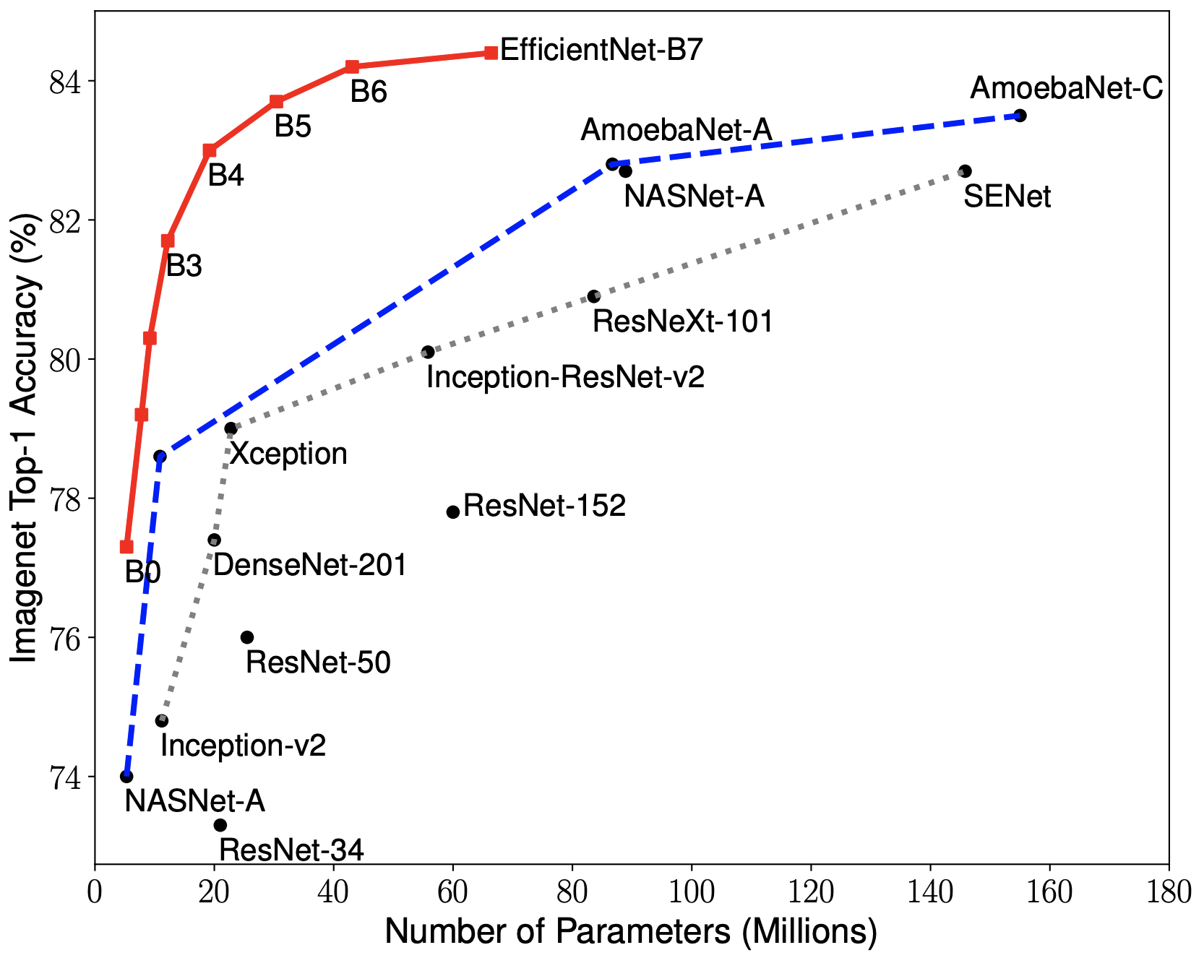
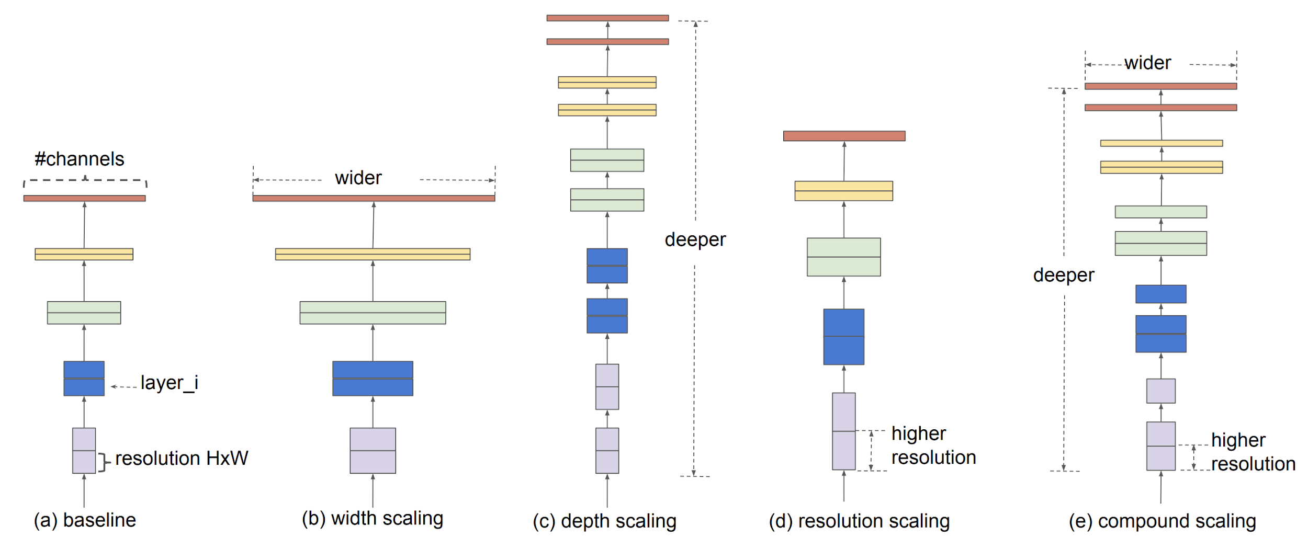
Classification: EfficientNet (2019)
Idea: AutoML + Compound scaling
Paper
Code

Slide 2
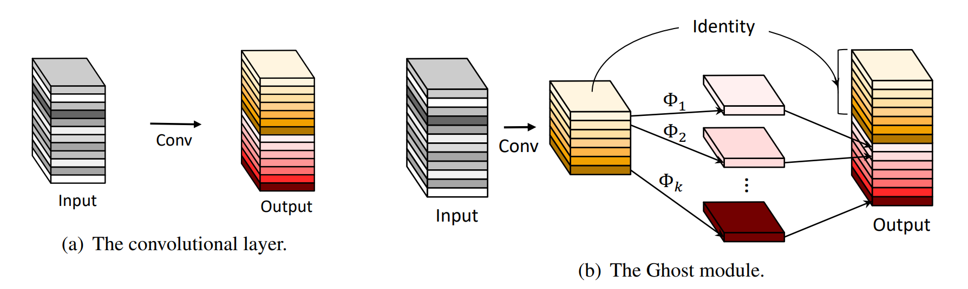
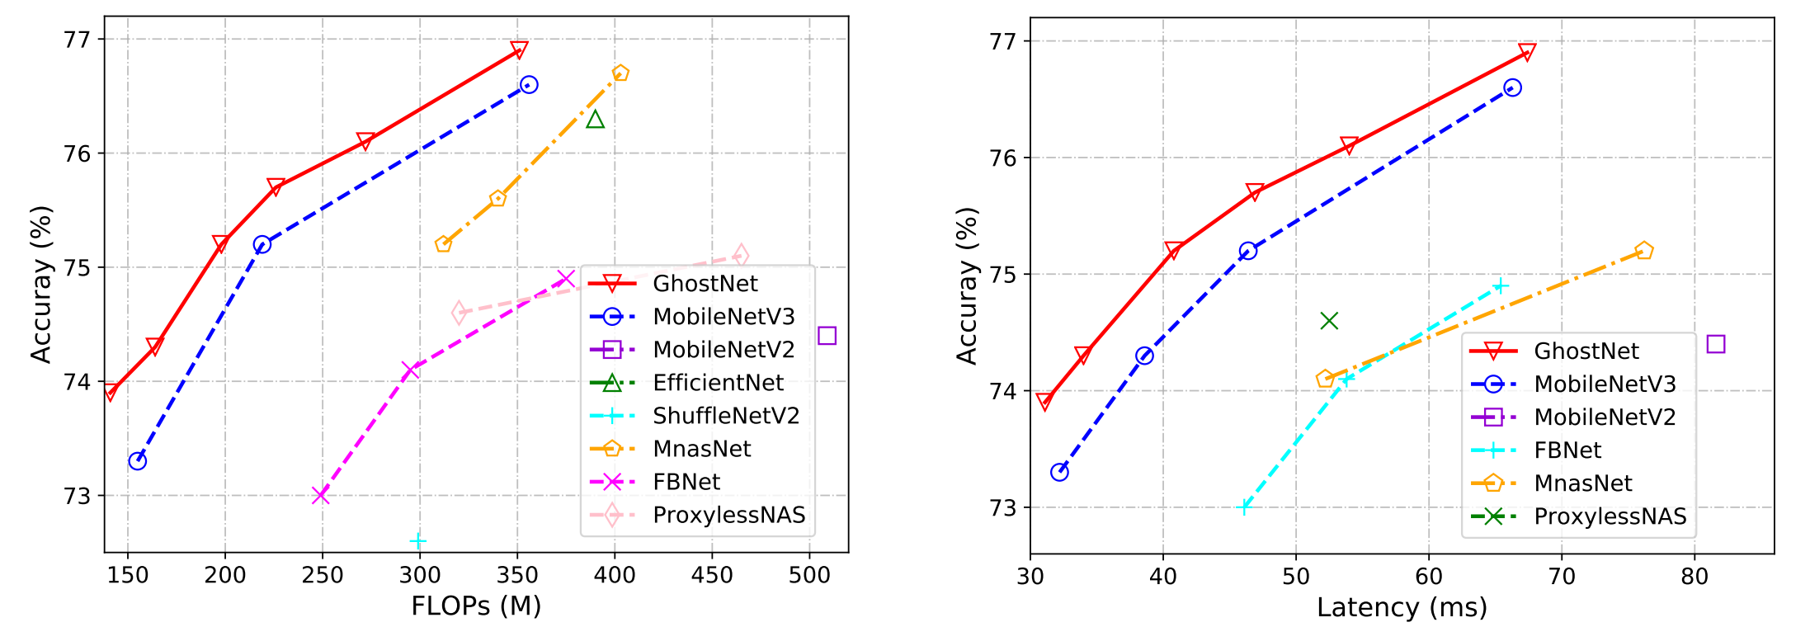
Classification: GhostNet (2019-2020)
Idea: Ghost module
Paper
Code

Slide 4
Detection
Datasets & Metrics

Slide 5
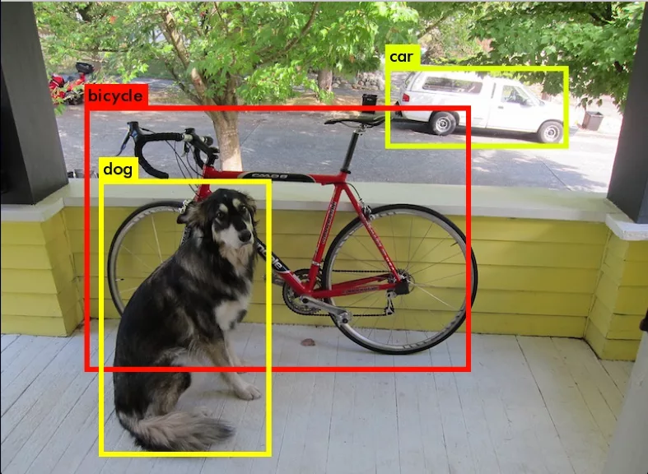
Object Detection: Task statement
Input: Image (np.array)
Output: “bounding boxes with class labels”
Each BBox is:
Top-Left corner: (x_tl, y_tl)
Bottom-Right corner: (x_br, y_br)
Class name
Confidence (probability of this class)
⇒ 6 numbers per each box

Slide 6

Object Detection: Data
PASCAL VOC 2012
MS COCO 2017
ImageNet
Google Open Images v6
Epic Kitchens

Slide 7
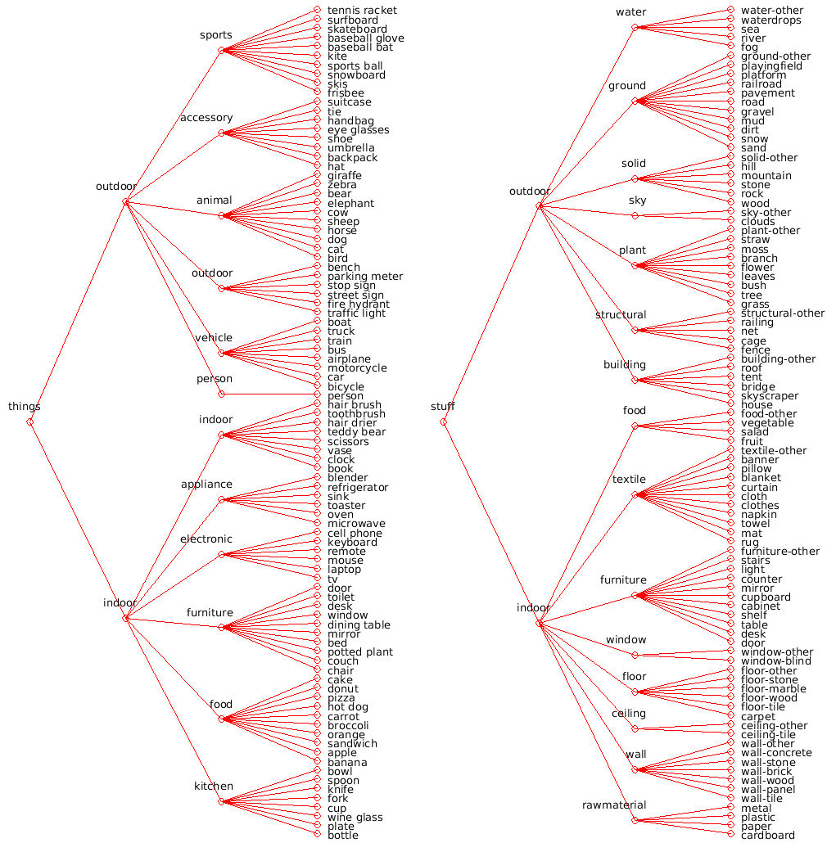
MS COCO 2017
MicroSoft Common Objects in COntext
80 classes
Train: ~120k images ~18GB
Val: ~5k images ~1GB
Test: ~40k images ~6GB
Vary in size and quality
Paper

Slide 8
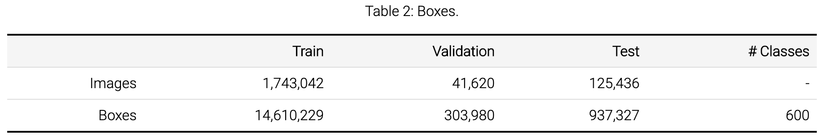
Google Open Images v6
Details:
https://storage.googleapis.com/openimages/web/factsfigures.html
Kaggle:
https://www.kaggle.com/c/open-images-object-detection-rvc-2020

Slide 9
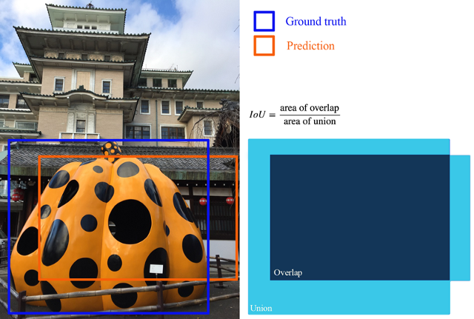
Intersection over Union (IoU, Jaccard index)

Slide 10
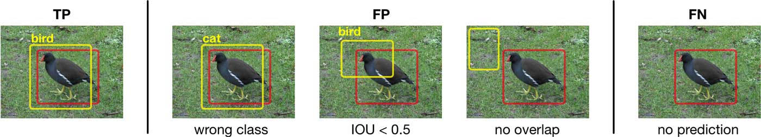
Positives & Negatives
https://machinethink.net/images/object-detection/tp-fp-fn@2x.jpg

Slide 11
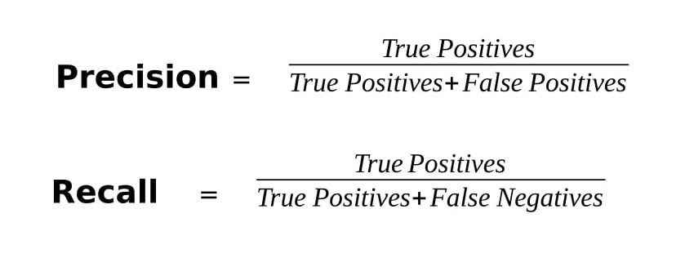
Precision, recall

Slide 12
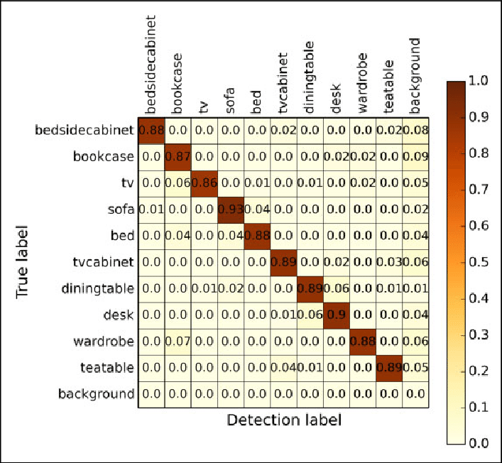
Confusion matrix
https://www.researchgate.net/publication/338728961/figure/fig2/AS:849968428507136@1579659673792/The-confusion-matrix-of-object-detection.png

Slide 13

mean Average Precision (mAP)
Good explanation

Slide 14
Let’s invent our own detector

Slide 15
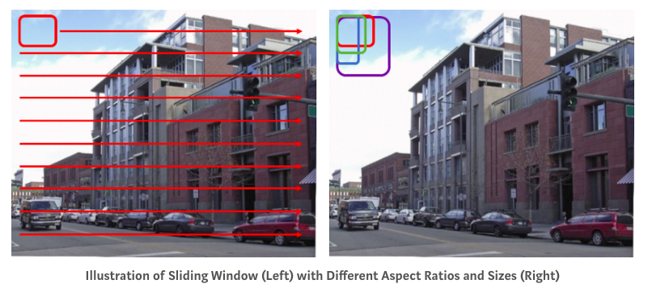
Let’s invent our own detector

Slide 16
Summary
Detection task is not easy
Datasets are quite large and accessible
Metrics are specific, but reasonable
Simple object detector invented

Slide 18
Two-stage detectors
RCNN, Fast-RCNN, Faster-RCNN

Slide 19
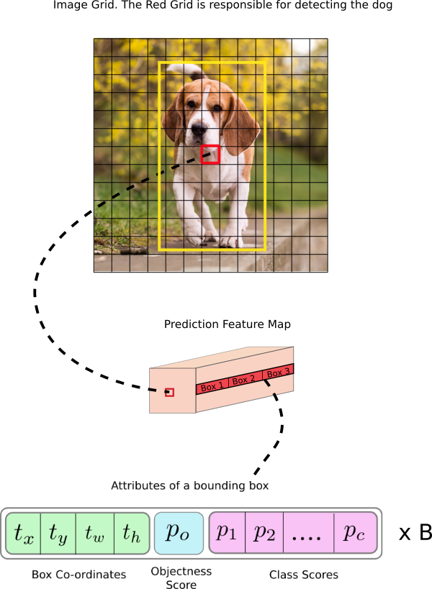
Detection: Core idea
Make default boxes assumptions
Regress their corners coordinates
Predict class inside each box
Filter not confident predictions

Slide 20
Detection: Core idea
Make default boxes assumptions “Anchor boxes”
Regress their corners coordinates Simultaneously
Predict class inside each box
Filter not confident predictions Non-max suppression (NMS)

Slide 21
Detection: Taxonomy
Detectors
Two-Stage (Proposal-based)
RCNN
Fast RCNN
Faster RCNN
Mask RCNN
One-Stage
SSD
YOLOv3
DSOD
RFBNet
Points-based
CenterNet
CornerNet
ExtremeNet
EfficientDet (NAS)
Time

Slide 22
Detection: Taxonomy
Detectors
Two-Stage (Proposal-based)
RCNN
Fast RCNN
Faster RCNN
Mask RCNN
One-Stage
SSD
YOLOv3
DSOD
RFBNet
Points-based
CenterNet
CornerNet
ExtremeNet
EfficientDet (NAS)
Time

Slide 23
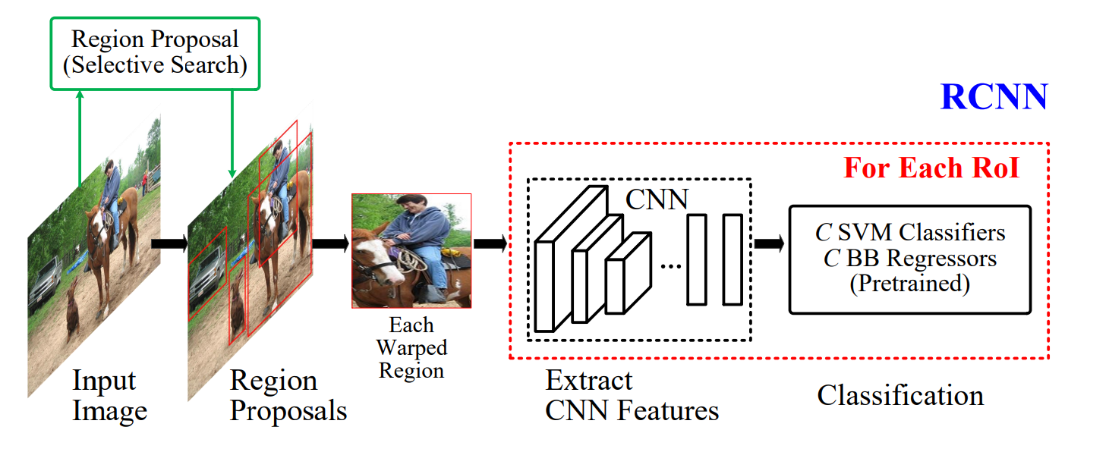
Detection: Two-stage (proposal-based)
https://arxiv.org/abs/1905.05055

Slide 24
Detection: Two-stage (proposal-based)
Generate boxes proposals (with separate algorithm / net)
https://arxiv.org/abs/1905.05055

Slide 25
Detection: Two-stage (proposal-based)
Generate boxes proposals (with separate algorithm / net)
Warp them to one shape
https://arxiv.org/abs/1905.05055

Slide 26
Detection: Two-stage (proposal-based)
Generate boxes proposals (with separate algorithm / net)
Warp them to one shape
Regress and classify them (with another algorithm)
https://arxiv.org/abs/1905.05055

Slide 27
Detection: Two-stage (proposal-based)
Generate boxes proposals (with separate algorithm / net)
Warp them to one shape
Regress and classify them (with another algorithm)
Post-process predictions
https://arxiv.org/abs/1905.05055

Slide 28
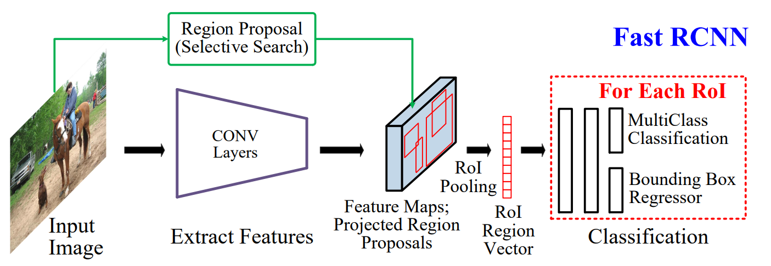
Detection: Two-stage (proposal-based)
Generate boxes proposals (with separate algorithm / net)
Warp them to one shape
Regress and classify them (with another algorithm)
Post-process predictions
https://arxiv.org/abs/1905.05055

Slide 29
Detection: Backbone
Generate boxes proposals (with separate algorithm / net)
Warp them to one shape
Regress and classify them (with another algorithm)
Post-process predictions
Backbone
https://arxiv.org/abs/1905.05055

Slide 30
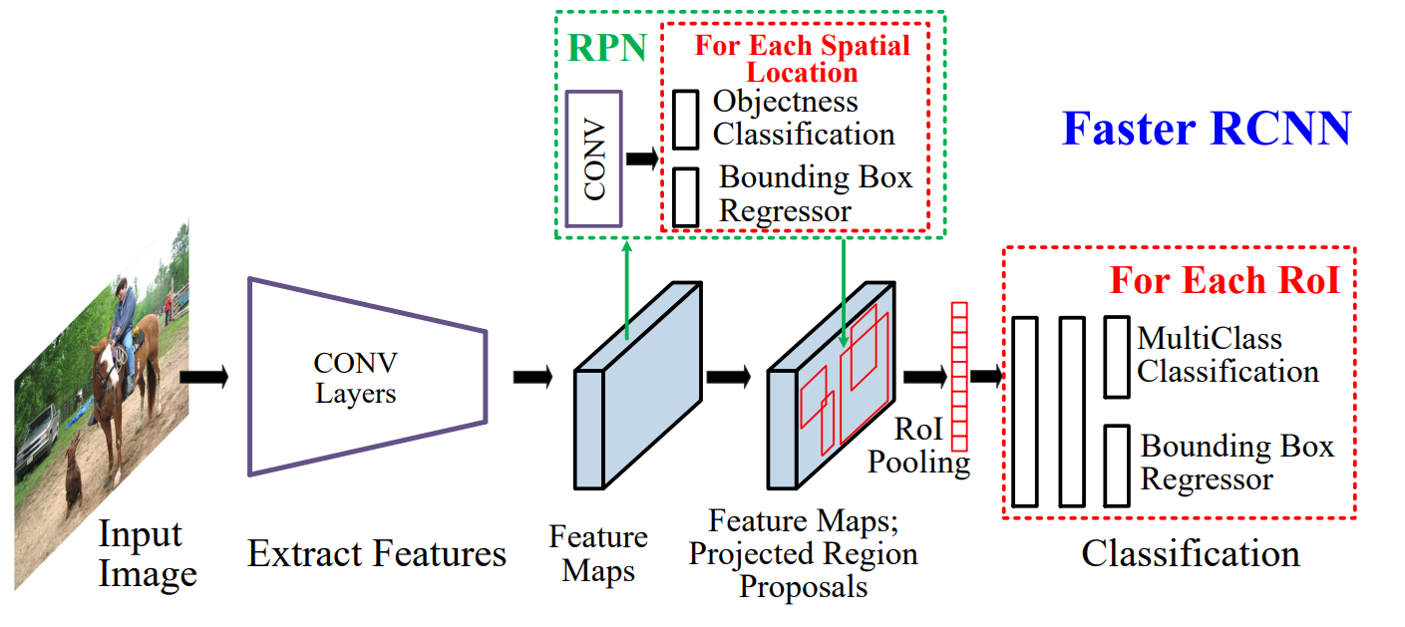
Detection: Two-stage (proposal-based)
Generate boxes proposals (with separate algorithm / net)
Warp them to one shape
Regress and classify them (with another algorithm)
Post-process predictions
https://arxiv.org/abs/1905.05055

